Slide 1

Wachsen BookStore
Bring Knowledge To The Human

Slide 2




team
Nguyễn Thị Hồng Hạnh
Bảo Huyền Tôn Nữ Thị Thu Ngân
Phan Thị Thanh Hiền
Hồ Thị Cưa

Slide 3

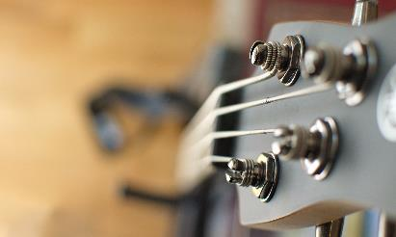


OUTLINE
General
Design
Demo

Slide 4
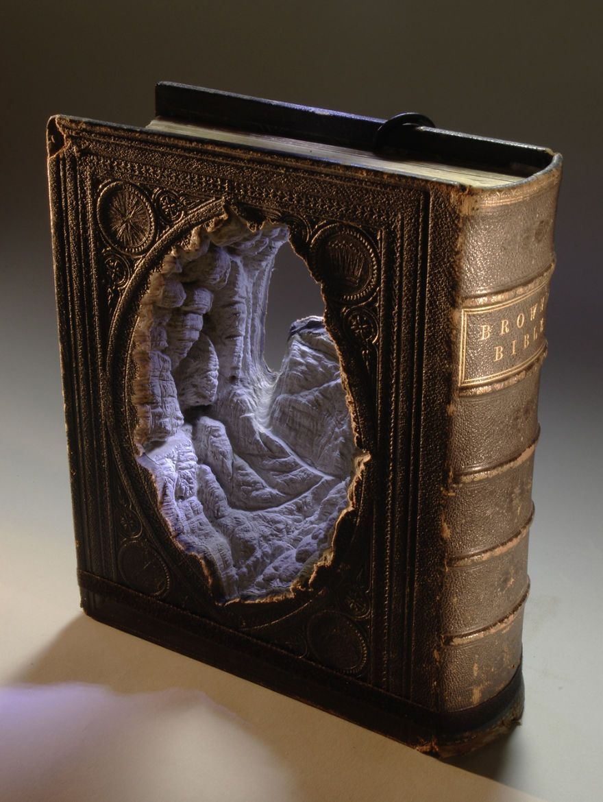



INTRODUCE
Books are a source of human knowledge, a tool to store human knowledge. When human invent a tool to write to rocks, from there they know their ancestors and many things left by ancestors. Today, book still a precious although the way to read book have many change

Slide 5
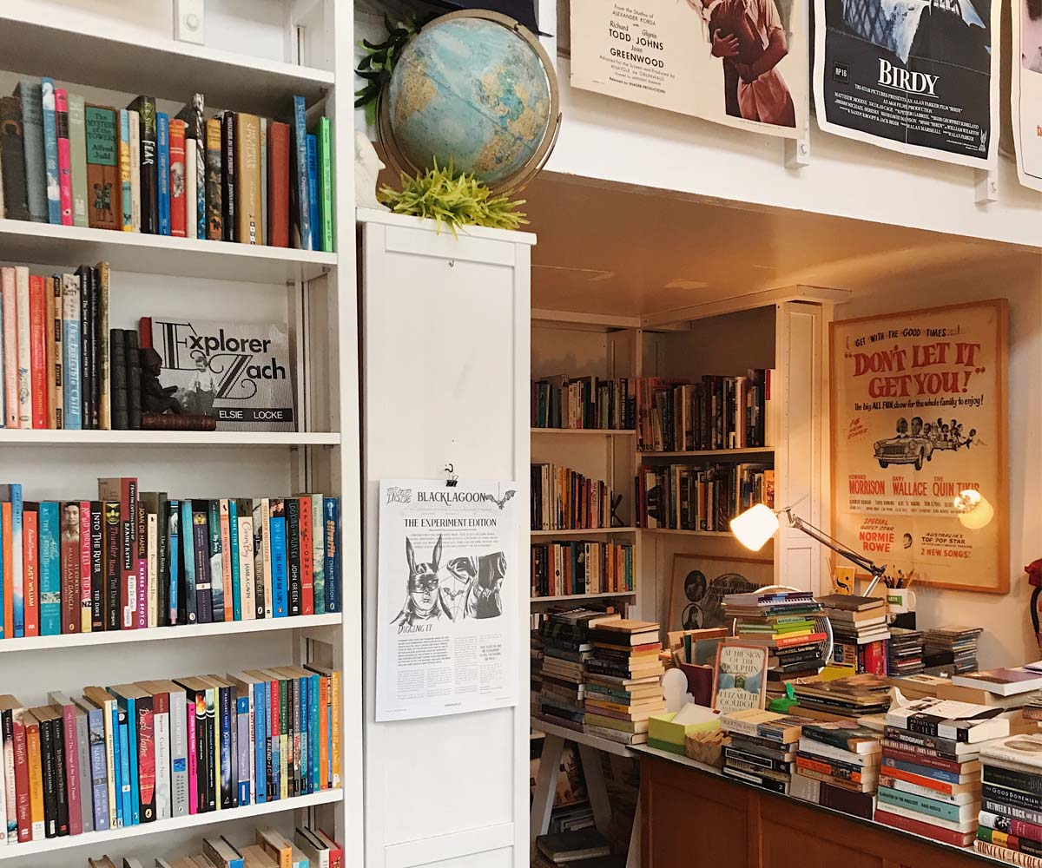

General
Book and life

Slide 6
Read Book, past or present
Past
Present
Go to library
Waste a day to find a book.
Sometimes don’t have book you want
You don’t know content of it is fit to you.
At home.
1 minutes.
Book is all in front of you.
Many people already read and leave rivew.

Slide 7
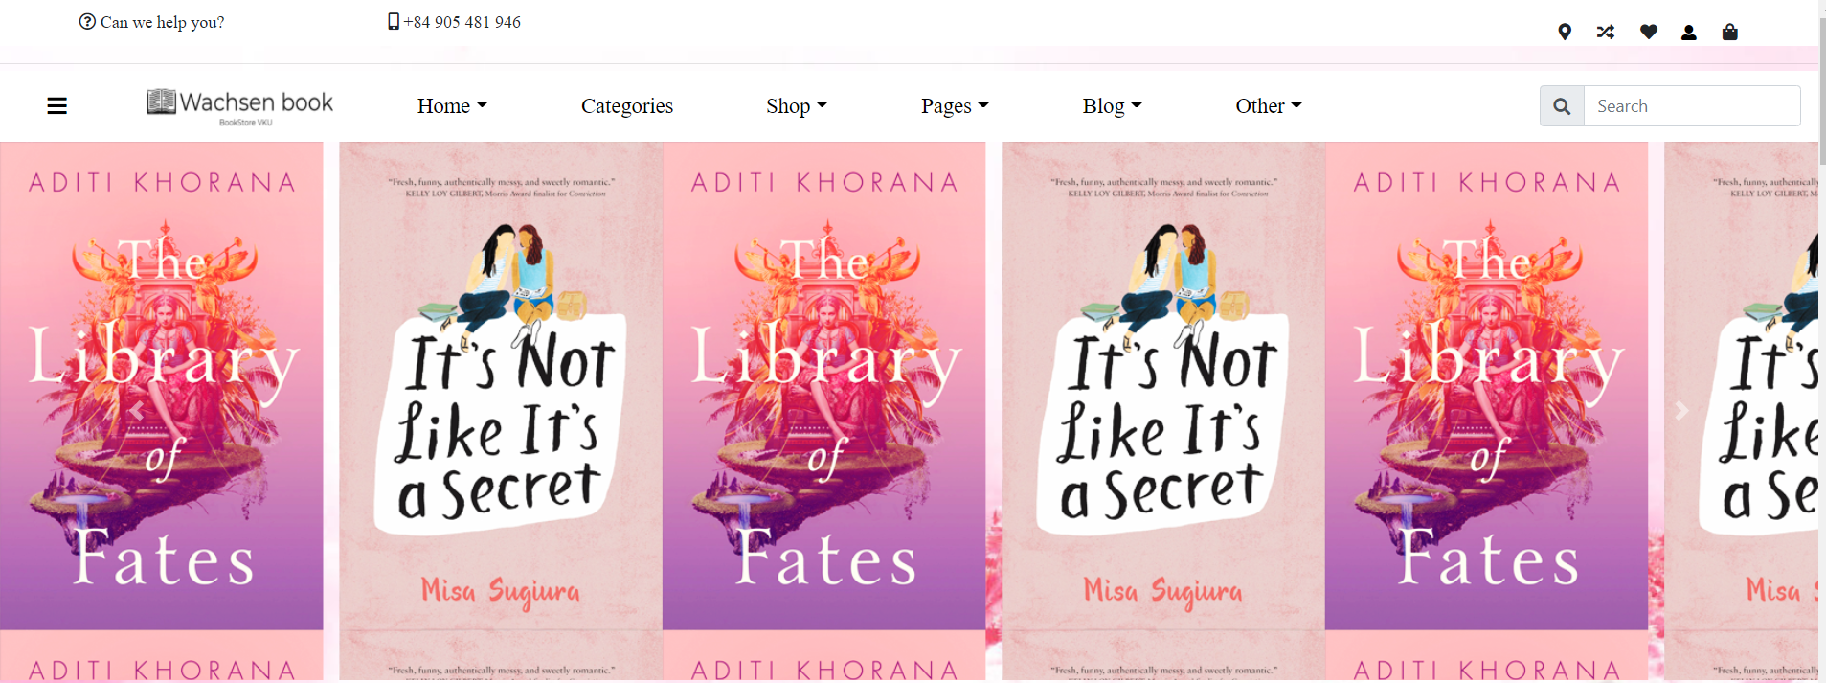
Reason why we don’t change to have a great experience
WACHSEN BOOK

Slide 8

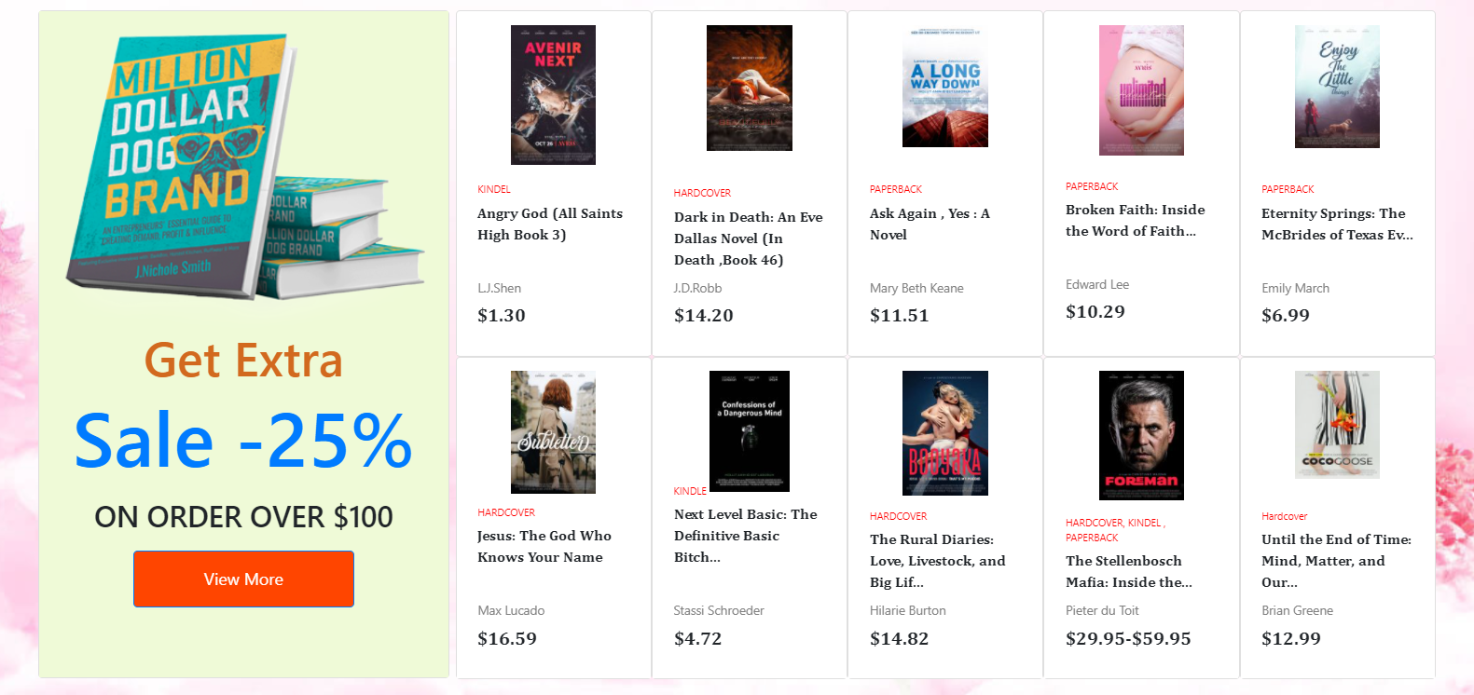
DESIGN
Wachsen Book In the future, books are an indispensable treasure in life. The higher the 4.0 era, the more powerful knowledge is

Slide 9
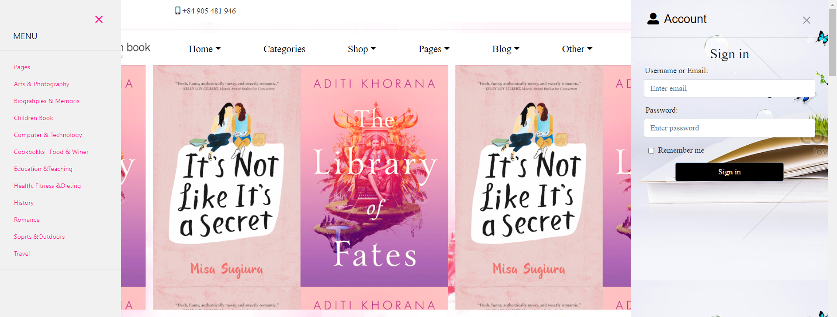
Header my website
With a mix of Card Carousel Bootstrap 4, we have come up with an eye-catching first page header with vibrant colors.
Along with using Javascript to create menu items and sign in in a very unique and convenient way

Slide 10
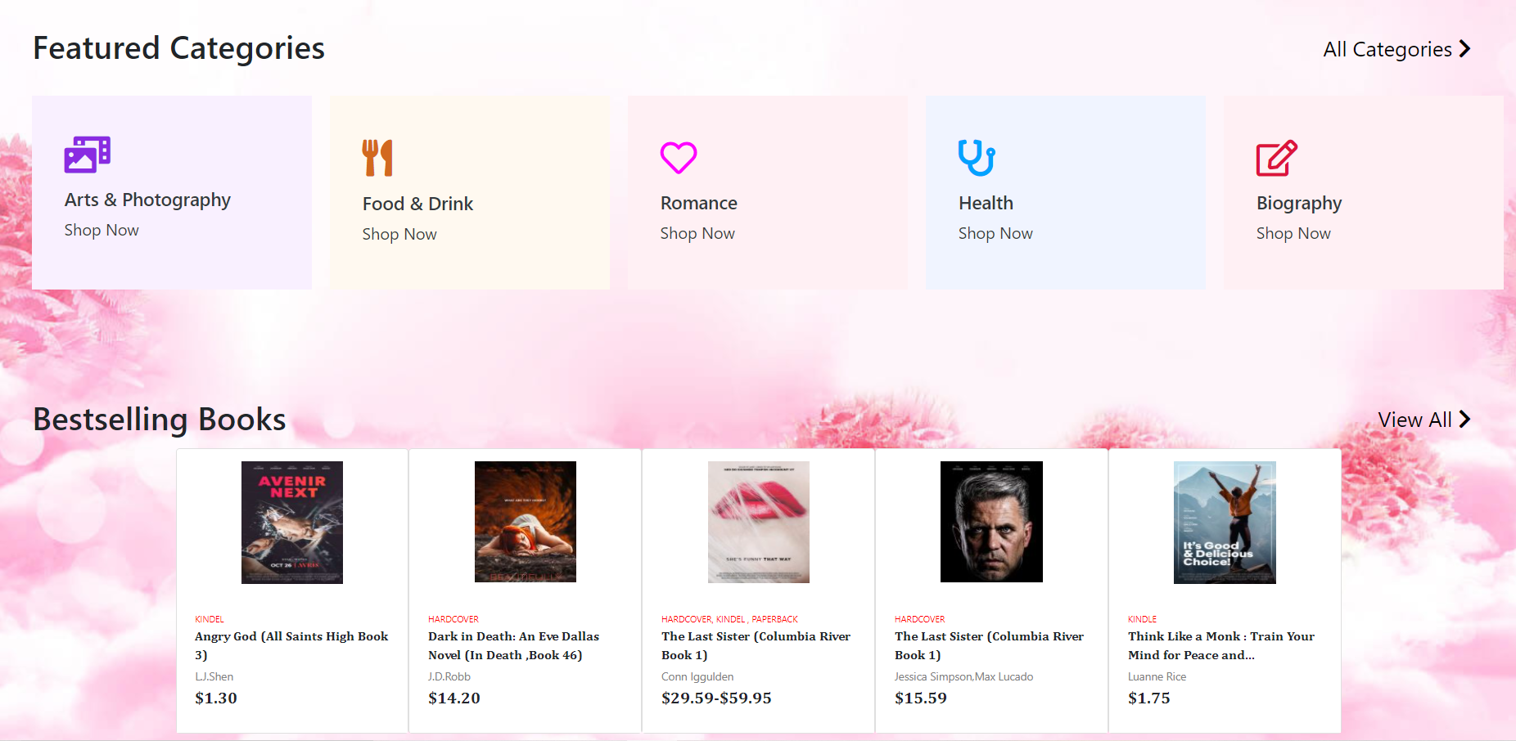
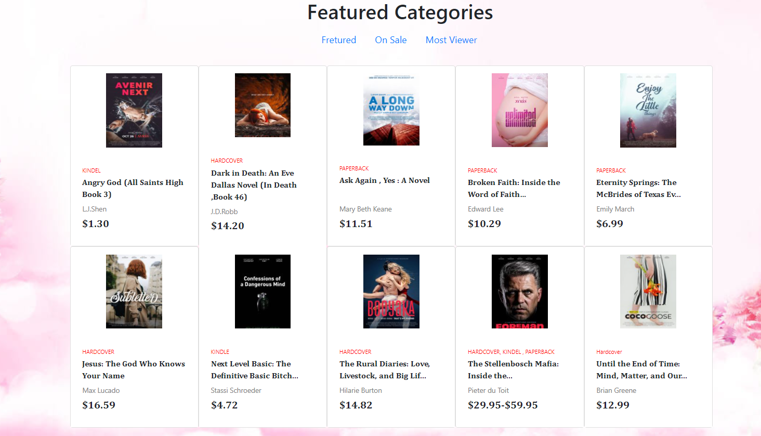
Body my website
The combination of cards, items and divs has resulted in Featured Categories and Bestselling Book sections to add more choices for you.
Use Bootstrap 4 Navs to create multiple book entries for you

Slide 11
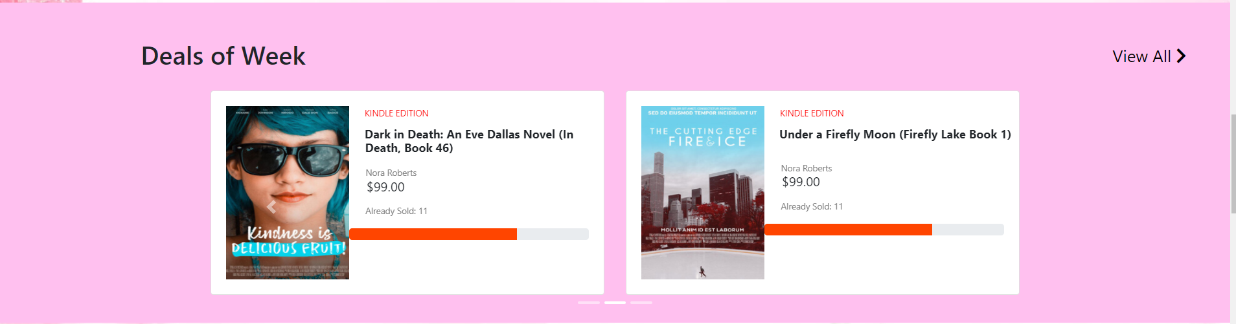
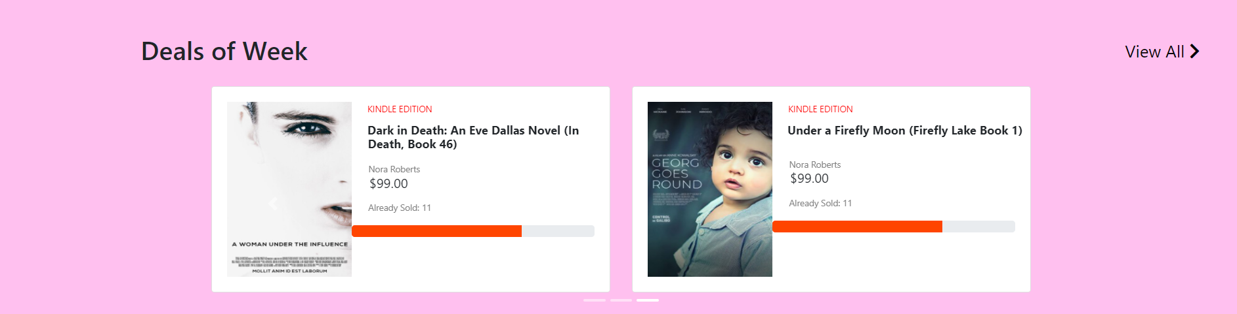
Body my website
Book deals of the week also become more eye-catching by using Card Caurosel Bootstrap 4

Slide 12
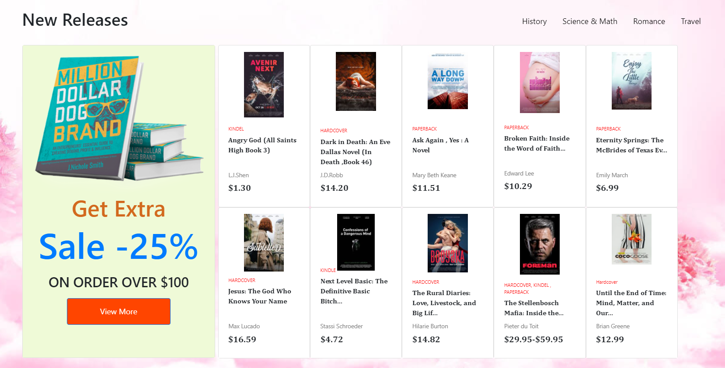
Body my website

Slide 13
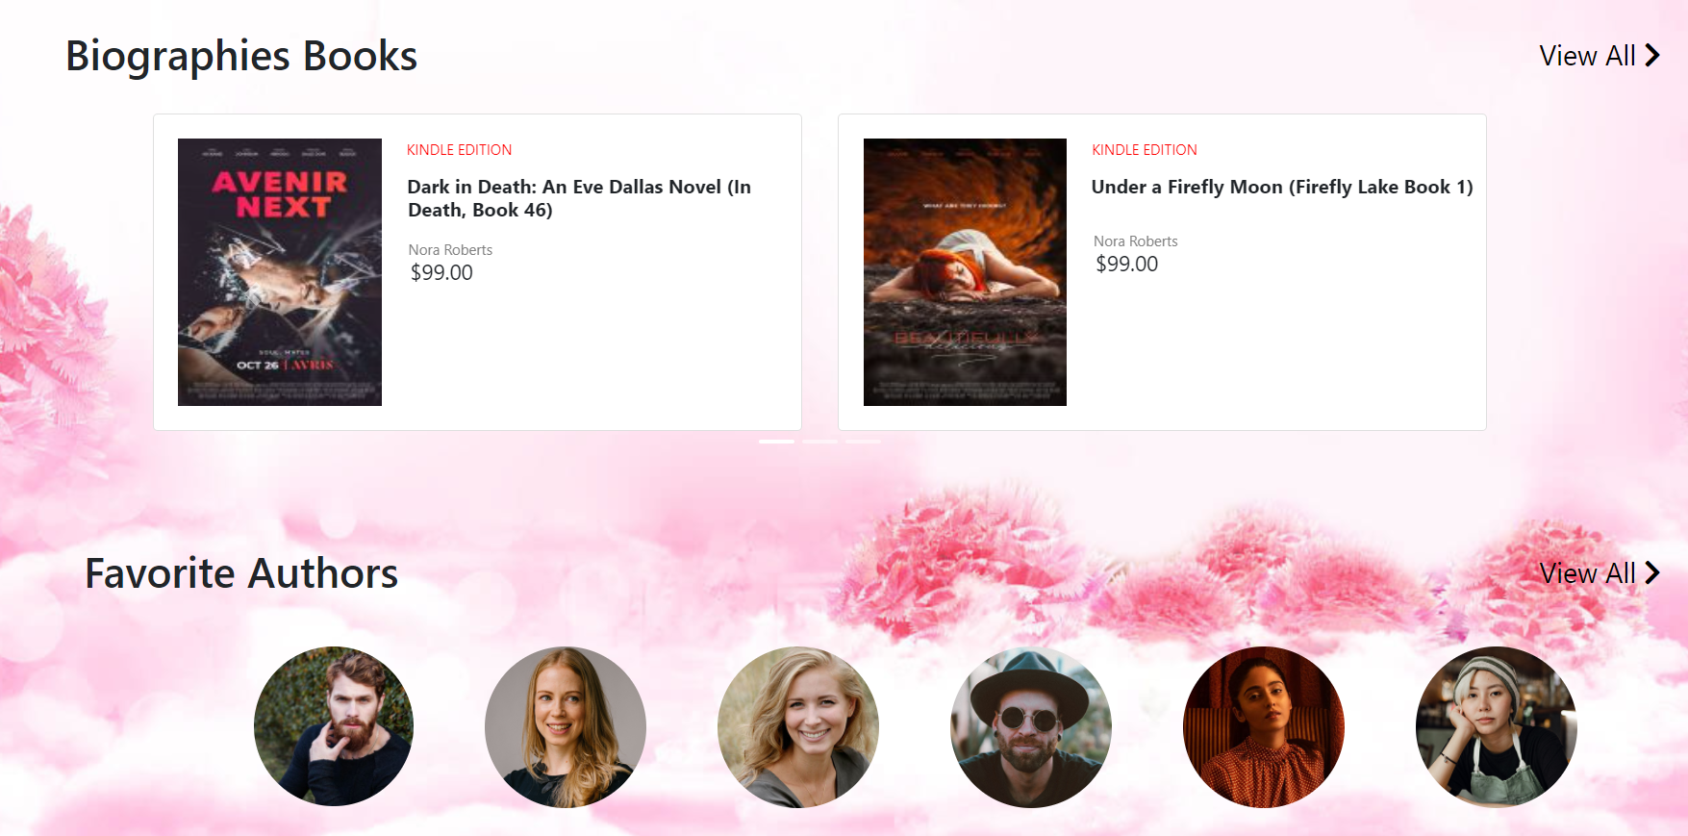
BODY MY WEBSITE
The combination of js and img class img-fluid rounded-circle has resulted in Biographies Books with auto-motion and fun circles for Favorite Authors

Slide 14
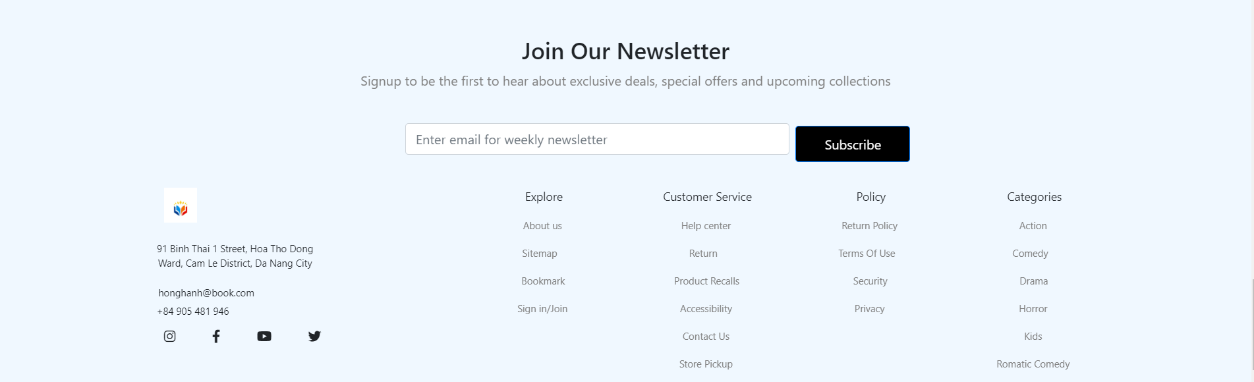
FOOTER MY WEBSITE

Slide 15
Finally, we would like to demo our product
WACHSEN BOOK

Slide 16

Thank you
Presenter Name
Email Address
Website Address

